Slide 1
Entity Relationship Diagram

Slide 2
What is ER diagram?
Also known as an entity relationship model
As a graphical representation
Depicts relationships among
people, objects, places, concepts or events within an information technology (IT) system.

Slide 3
What is ER diagram in simple words?
The relationships of entity sets stored in a database
ER diagrams help to explain the logical structure of databases

Slide 4
Main components
ER diagrams are created based on three basic concepts
Entities
Attributes
relationships.

Slide 5
Main components and its symbols
Rectangles to represent entities
Ovals to define attributes
Diamond shapes to represent relationships.

Slide 6
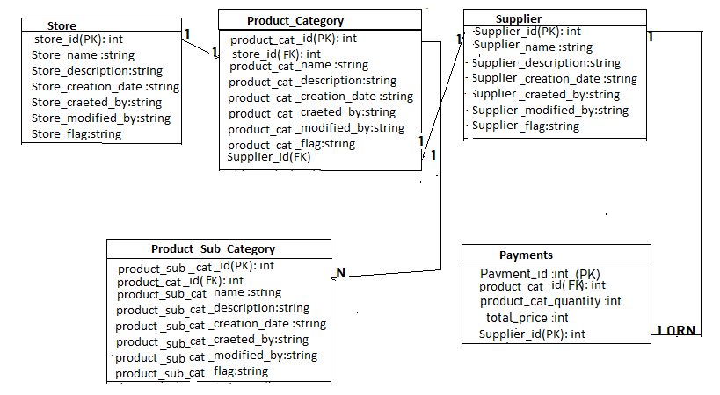
ER Diagram of inventory system

Slide 7
Styles of ERD
Chen Style
Bachman Style
Martin Style
Crows-foot

Slide 8
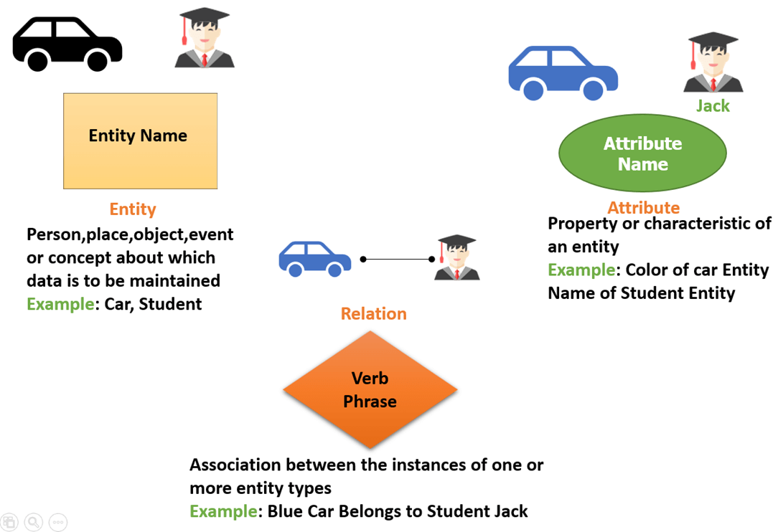

Slide 9


Entities
An entity is an object or concept about which you want to store information
which are represented by rectangles.
weak entity
A weak entity is an entity that must defined by a foreign key relationship with another entity
as it cannot be uniquely identified by its own attributes alone.

Slide 10

Actions
Shows how two entities share information in the database.
Actions are represented by diamond shapes

Slide 11


Attributes
A key attribute is the unique, distinguishing characteristic of the entity.
For example, an employee's social security number might be the employee's key attribute.
Attribute represented by ovals
Multivalued attribute
A multivalued attribute can have more than one value
For example, an employee entity can have multiple skill values.

Slide 12
Keys
Primary key, Foreign key, Unique key, Alternate key, Candidate Key, Super key
Search yourself…

Slide 13
Connecting lines
solid lines that connect attributes to show the relationships of entities in the diagram.
Cardinality
specifies how many instances of an entity relate to one instance of another entity.
one-o-one
one-to-many
many-to-one
Many-to-many

Slide 14
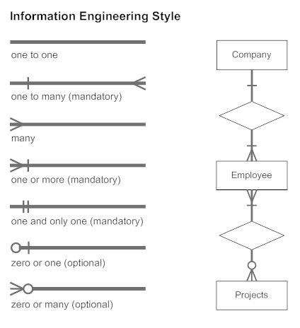
Example:

Slide 15
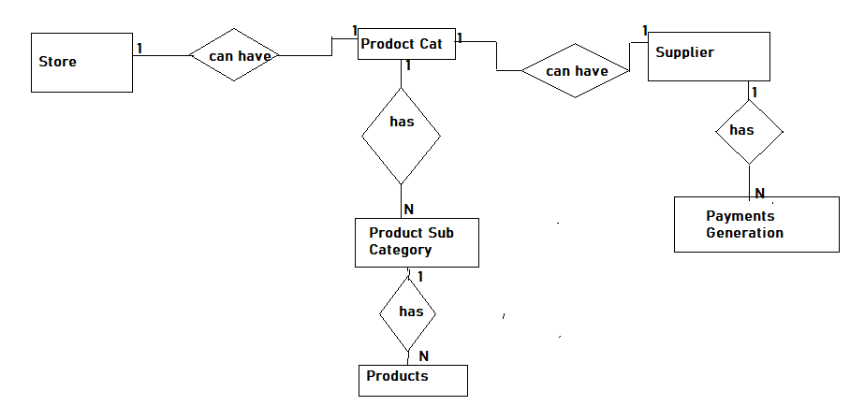
Chen Model of Inventory System

Slide 16

Steps to draw ER diagram

Slide 17
Steps to draw ER diagram
Identify entities and relationships.
Look at two entities, are they related? If so draw a solid line connecting the two entities.
Describe the relationship.
How are the entities related? Draw an action diamond between the two entities on the line you just added.
In the diamond write a brief description of how they are related.
Add attributes. Any key attributes of entities should be added using oval-shaped symbols.
Complete the diagram. Continue to connect the entities with lines, and adding diamonds to describe each relationship until all relationships have been described. Each of your entities may not have any relationships, some may have multiple relationships. That is okay.

Slide 18
Example
In a university, a Student enrolls in Courses. A student must be assigned to at least one or more Courses. Each course is taught by a single Professor. To maintain instruction quality, a Professor can deliver only one course

Slide 19
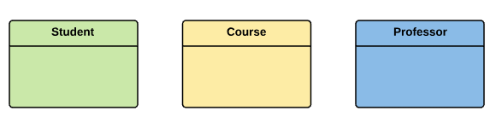
Step 1) Entity Identification
We have three entities
Student
Course
Professor

Slide 20
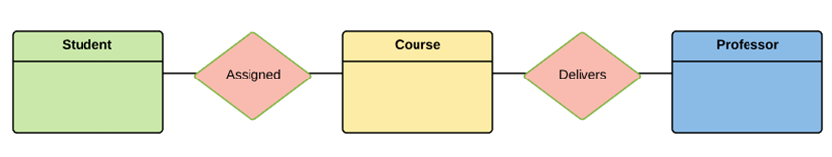
Step 2) Relationship Identification
We have the following two relationships
The student is assigned a course
Professor delivers a course

Slide 21
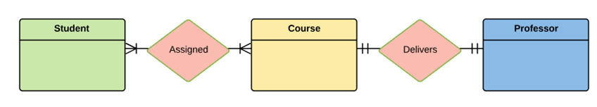
Step 3) Cardinality Identification
For them problem statement we know that,
A student can be assigned multiple courses
A Professor can deliver only one course

Slide 22
Step 4) Identify Attributes
Entity Primary Key Attribute
Student Student_ID StudentName
Professor Employee_ID ProfessorName
Course Course_ID CourseName

Slide 23
Reference:
ER Diagram: Entity Relationship Diagram Model | DBMS Example (guru99.com)

